Slide 1
An Analysis of EFL Students’ Self-Assessments: Exploring Student Awareness, Cognitive Bias, and Honest Intent
Philip Brannan
King Mongkut’s University of Technology Thonburi

Slide 2
Research Questions
Do students accurately self assess?
Is it possible to make students more inclined to accurately self-assess?
If students are both able to inclined to accurately self-assess, could student self-assessment be used as a component of summative assessment?

Slide 3
Peer Discussion Questions
Compared to the other people in this room, how would you rate yourself as a driver? Rate yourself from “1” to “10”, with “5” being average.

Slide 4
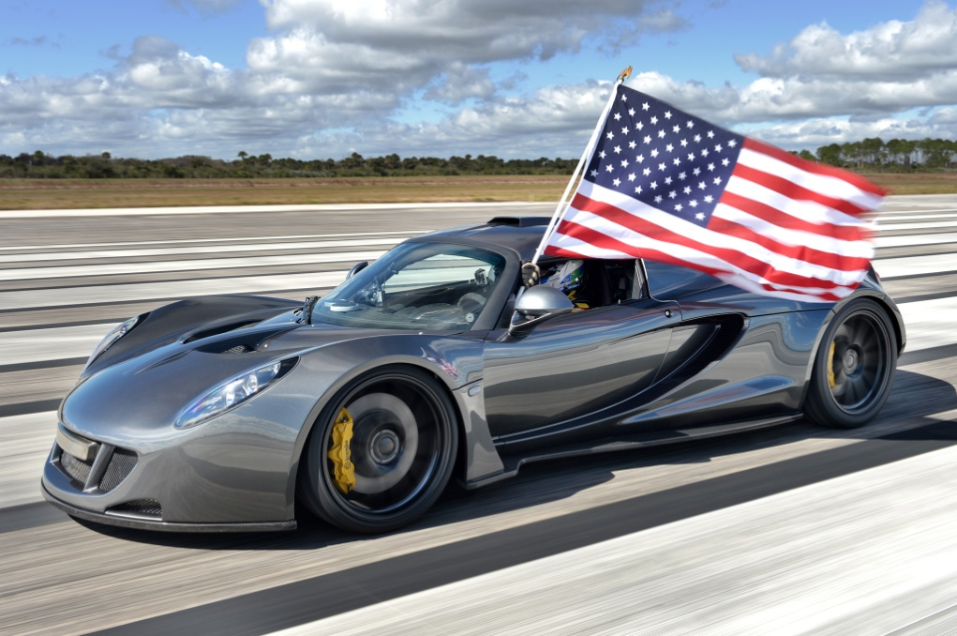
Background: Awareness and Cognitive Bias
Svenson (1981) investigated whether how people rated themselves as drivers
69% of Swedes, and 93% of Americans, rated themselves “above average”

Slide 5
Background: Cognitive Bias
Dunning & Kruger (1999) examined self-assessments of English grammar, logical reasoning, and recognizing humor
In all three categories, the majority of subjects considered themselves “above average”

Slide 6
Background: Awareness and Cognitive Bias
Below average students over-assessed their performance, while elite students slightly under-assessed

Slide 7
Background: Awareness and Cognitive Bias
Self-assessments compared to actual performance recognizing humor (Dunning and Kruger, 1999)

Slide 8
Background: Awareness and Cognitive Bias
“[C]onsider the ability to write grammatical English. ...the same knowledge that underlies the ability to produce correct judgement is also the knowledge that underlies the ability to recognize the correct judgement. To lack the former is to be deficient in the latter.” (Dunning and Kruger, 1999)

Slide 9
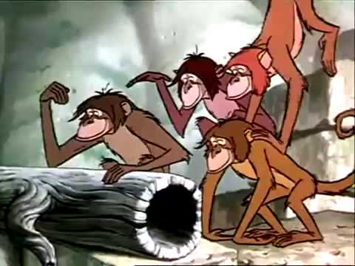
Background: Awareness and Cognitive Bias
Here we sit in a branchy row,
Thinking of beautiful things we know;
Dreaming of deeds that we mean to do,
All complete, in a minute or two—
Rudyard Kipling’s “Road-Song of the Bandar-log”

Slide 10
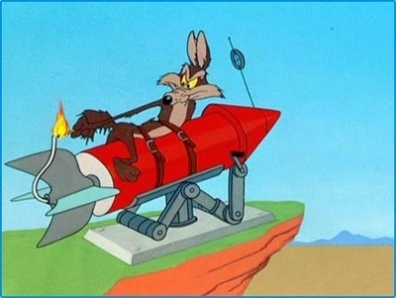
Background: Awareness and Cognitive Bias

Slide 11
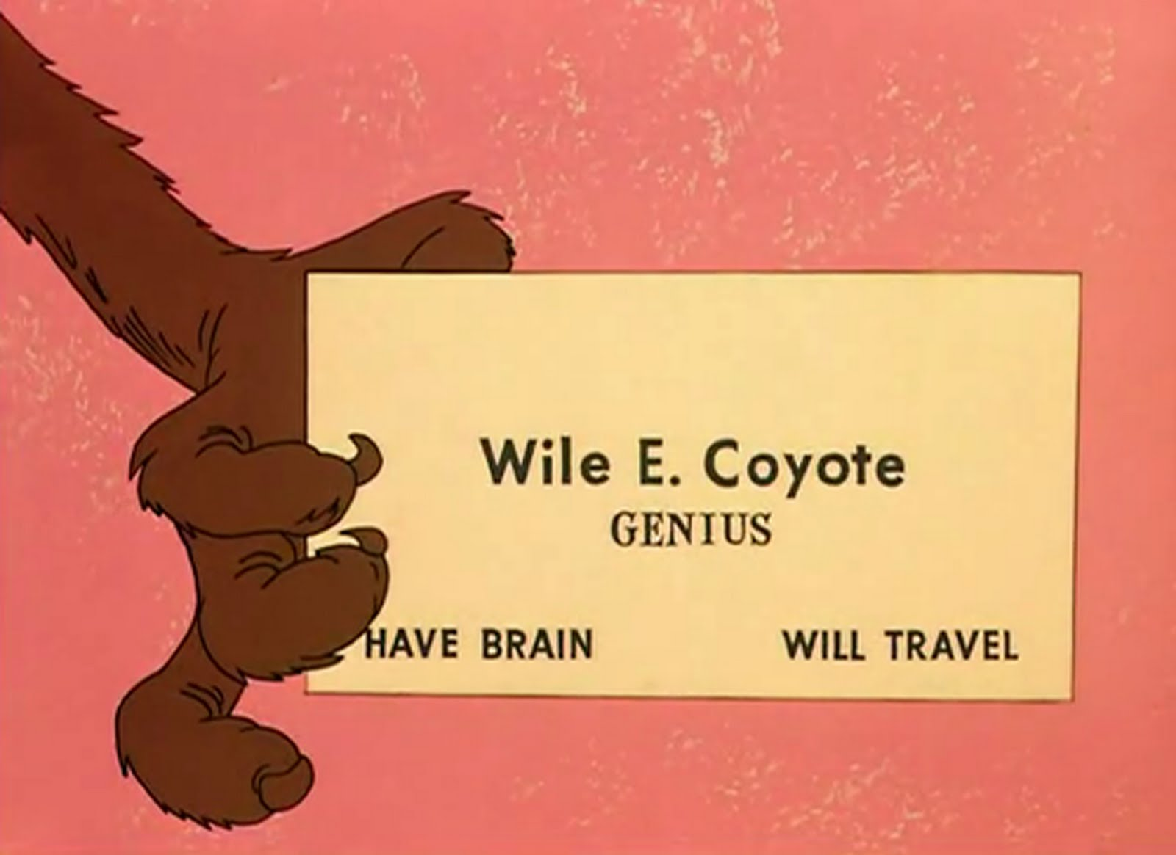
Background: Awareness and Cognitive Bias

Slide 12
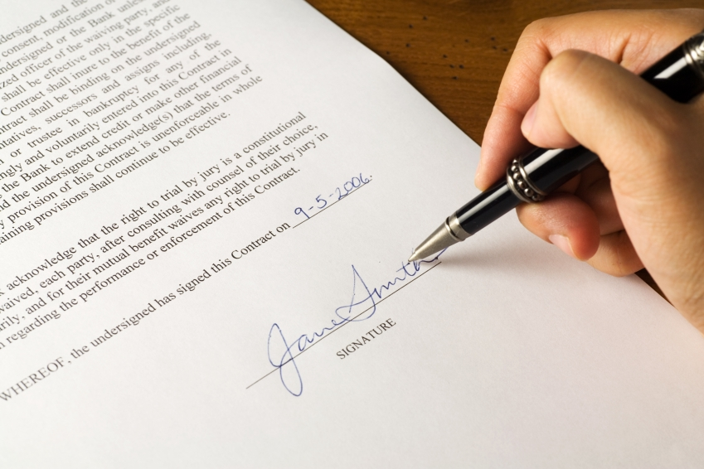
Background: Honest Intent
Typically, witnesses swear to be honest at the start of their testimony
However, contracts are signed at the end

Slide 13
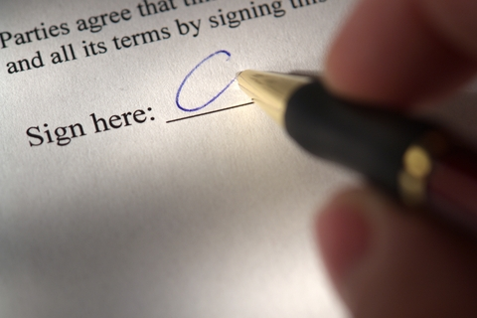
Peer Discussion Questions
Do you think people are more inclined to be honest if they sign at the start or at the end of a document?

Slide 14
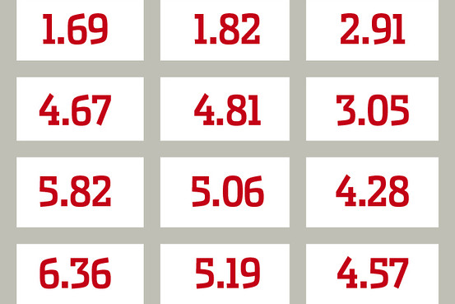
Background: Honest Intent
Students were given a “matrix task” in which they were paid for the number of boxes which had a combination of “10” that they could find in a limited time

Slide 15
Background: Honest Intent

Slide 16
Background: Honest Intent
The first group of students could not cheat; they served as the control group
The second group of students could cheat and were required to sign their name at the bottom of their paper
The second group of students could cheat and were required to sign their name at the top of their paper

Slide 17
Peer Discussion Questions
How much do you think the top-signing and/or bottom-signing group cheated?
Which group do you think cheated more?

Slide 18
Methods
80 first-year EFL students at King Monkgut’s University of Technology Thonburi were asked to self-assess their performance following the completion one listening examination and three speaking presentations

Slide 19
Methods
Students rated themselves based on five criteria for the speaking self-assessment

Slide 20
Methods
Students were also instructed to sign to indicate that their self-assessment was honest

Slide 21
Methods
Students were randomly assigned to sign at the top or bottom of their self-assessments

Slide 22
Methods
For the listening examination, students were required to make a similar self assessment, though signature location was not analyzed

Slide 23
Peer Discussion Questions
Did students accurate self-assess; were students’ self-assessments similar to the actual scores that they received?
Was signature location salient?

Slide 24
Results
Signature location was not found to be salient (p = .280. 354, and .219, respectively)

Slide 25
Results
Students’ self assessments did correlate with the teachers’ assessments for all three speaking presentations (p = .014, .005, and .035, respectively)
There was some correlation for the listening exam, but it was not statistically significant (p = .103)

Slide 26
Results
Most students underestimated their score for the listening exam
Out of a maximum of 30 possible points, the average score was about 18.5, but the average predicted score was about 14.5, an underestimation of about 4 points.

Slide 27
Results

Slide 28
Results
Students tended to over-assess their respective scores for the speaking presentations.
“3” is an average score, but students collectively self-assessed as 3.43, 3.62, and 3.67, respectively

Slide 29
Results

Slide 30
Research Questions
Do students accurately self assess?
Is it possible to make students more inclined to accurately self-assess?
If students are both able to inclined to accurately self-assess, could student self-assessment be used as a component of summative assessment?

Slide 31
Discussion and Conclusions
Signature location does not appear to have a significant effect upon self-assessment
However, as this study failed to provide a control group, it cannot be stated that signing would have no effect; only that signature location did not in this context

Slide 32
Peer Discussion Questions
Why did students tend to under-assess their listening examination performance but over-asses their speaking performances?

Slide 33
Discussion and Conclusions
Heine (2003) argues that over-assessment is minor or non-existent for East-Asians when they assess themselves as individuals

Slide 34
Discussion and Conclusions
However, Heine also notes that East-Asians overestimation is more pronounced for East-Asians when they assess themselves as groups

Slide 35
Discussion and Conclusion
The speaking presentations were group tasks, whereas the listening examination was an individual task

Slide 36
Peer Discussion Questions
Why did students more accurately self-assess their speaking performances?

Slide 37
Discussion and Conclusions
The speaking examination provided more detailed criteria
The most common self-assessment scores were “10”, “15” and “20” for the listening exam, whereas speaking presentation assessments did not tend to cluster

Slide 38
Discussion and Conclusions

Slide 39
Discussion and Conclusions

Slide 40
Discussion and Conclusions
Students can accurately self-assess to a degree, and may do so more accurately when the assessment process is more transparent to them

Slide 41
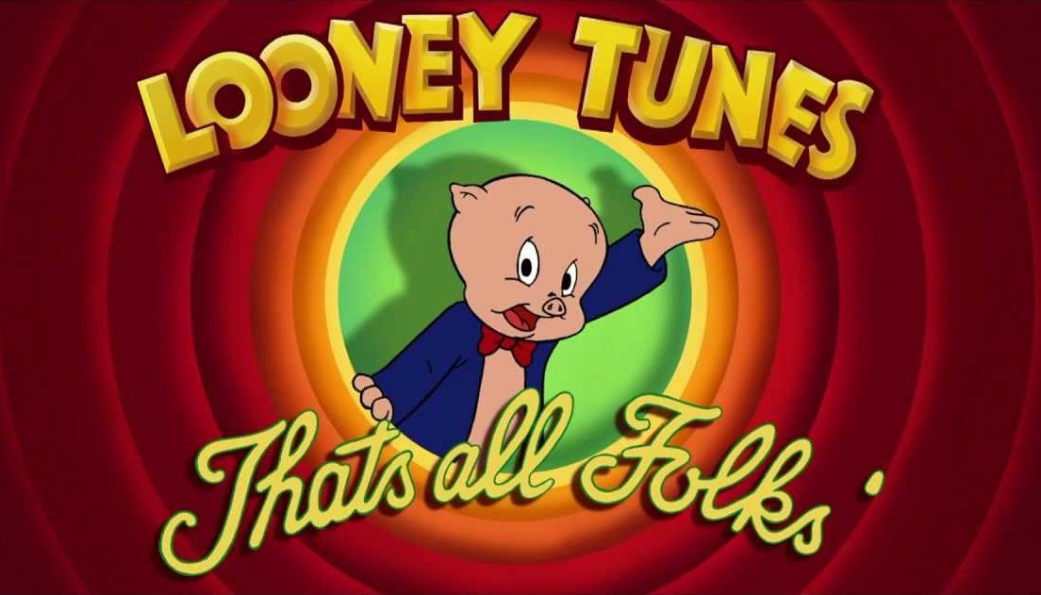
Questions or Comments?

